Slide 1
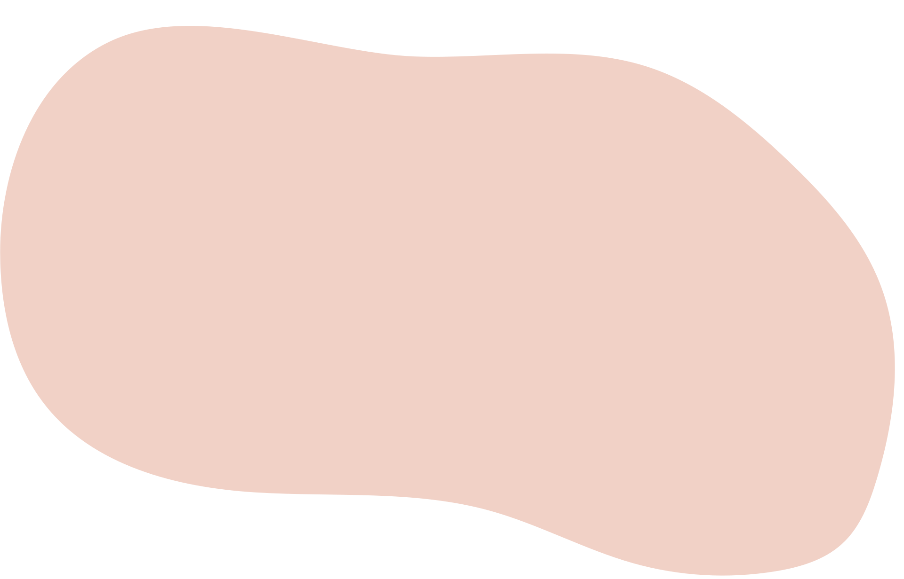












VOIDSCAPE
Don't let your mind control you,
take control of your mind

Slide 2







PROBLEM STATEMENT
Despite advancements in mental health awareness and treatment options, there remains a significant gap in accessible and effective solutions for individuals suffering from various mental illnesses. Our challenge is to develop a comprehensive and user-friendly website that offers innovative resources:-
VR Meditation
Games
Chatbot
Blogs

Slide 3



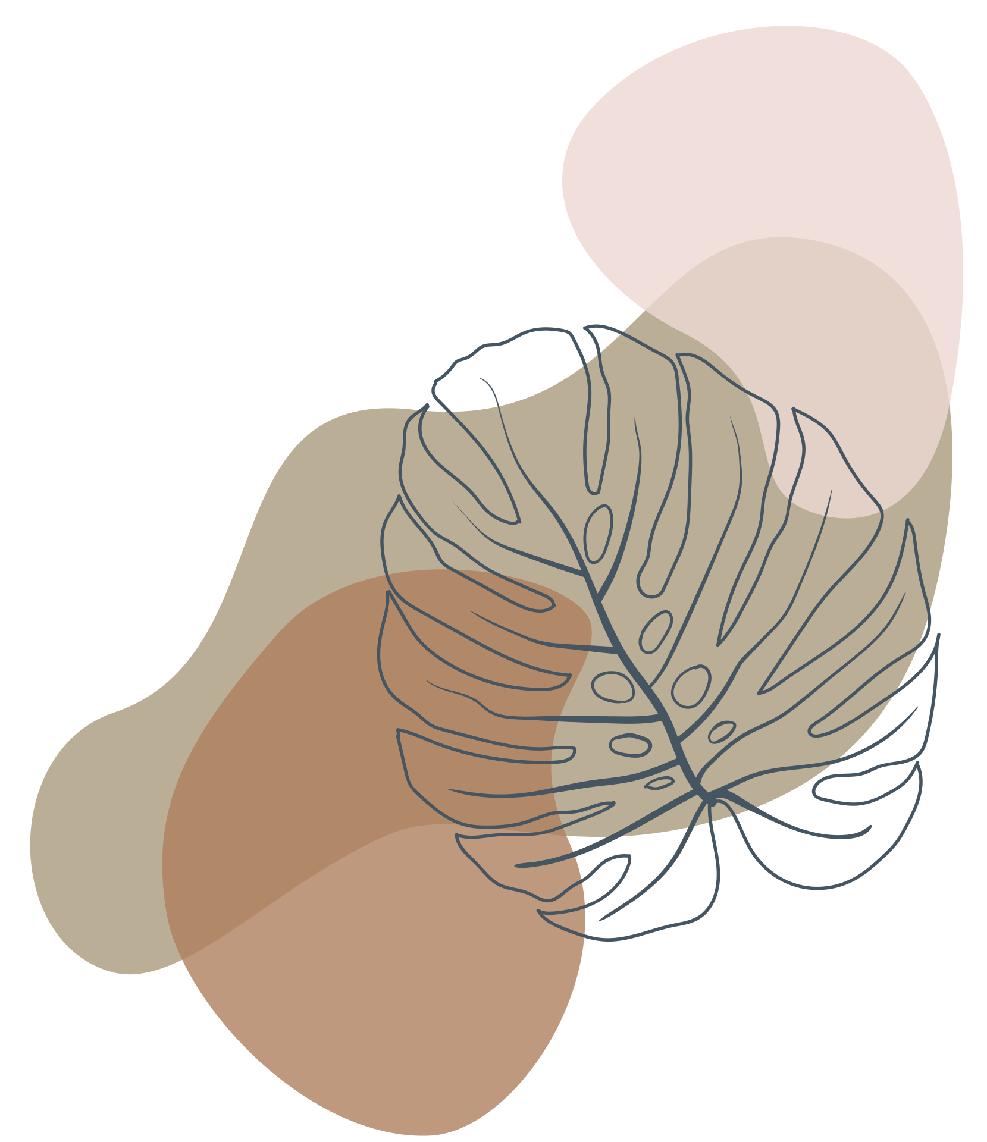
fereferf
Members
Avanish
Animesh
MENTORS
Ashutosh Mishra
Kartik Jhirwar
Kartik
Priyanshu Garg
Aditi
Ashutosh Sharma

Slide 4
fereferf
Open Website
Chatbot Interaction
Login/Signup
Suggestion
Play Games
VR Meditation
Blog/Video Resources

Slide 5
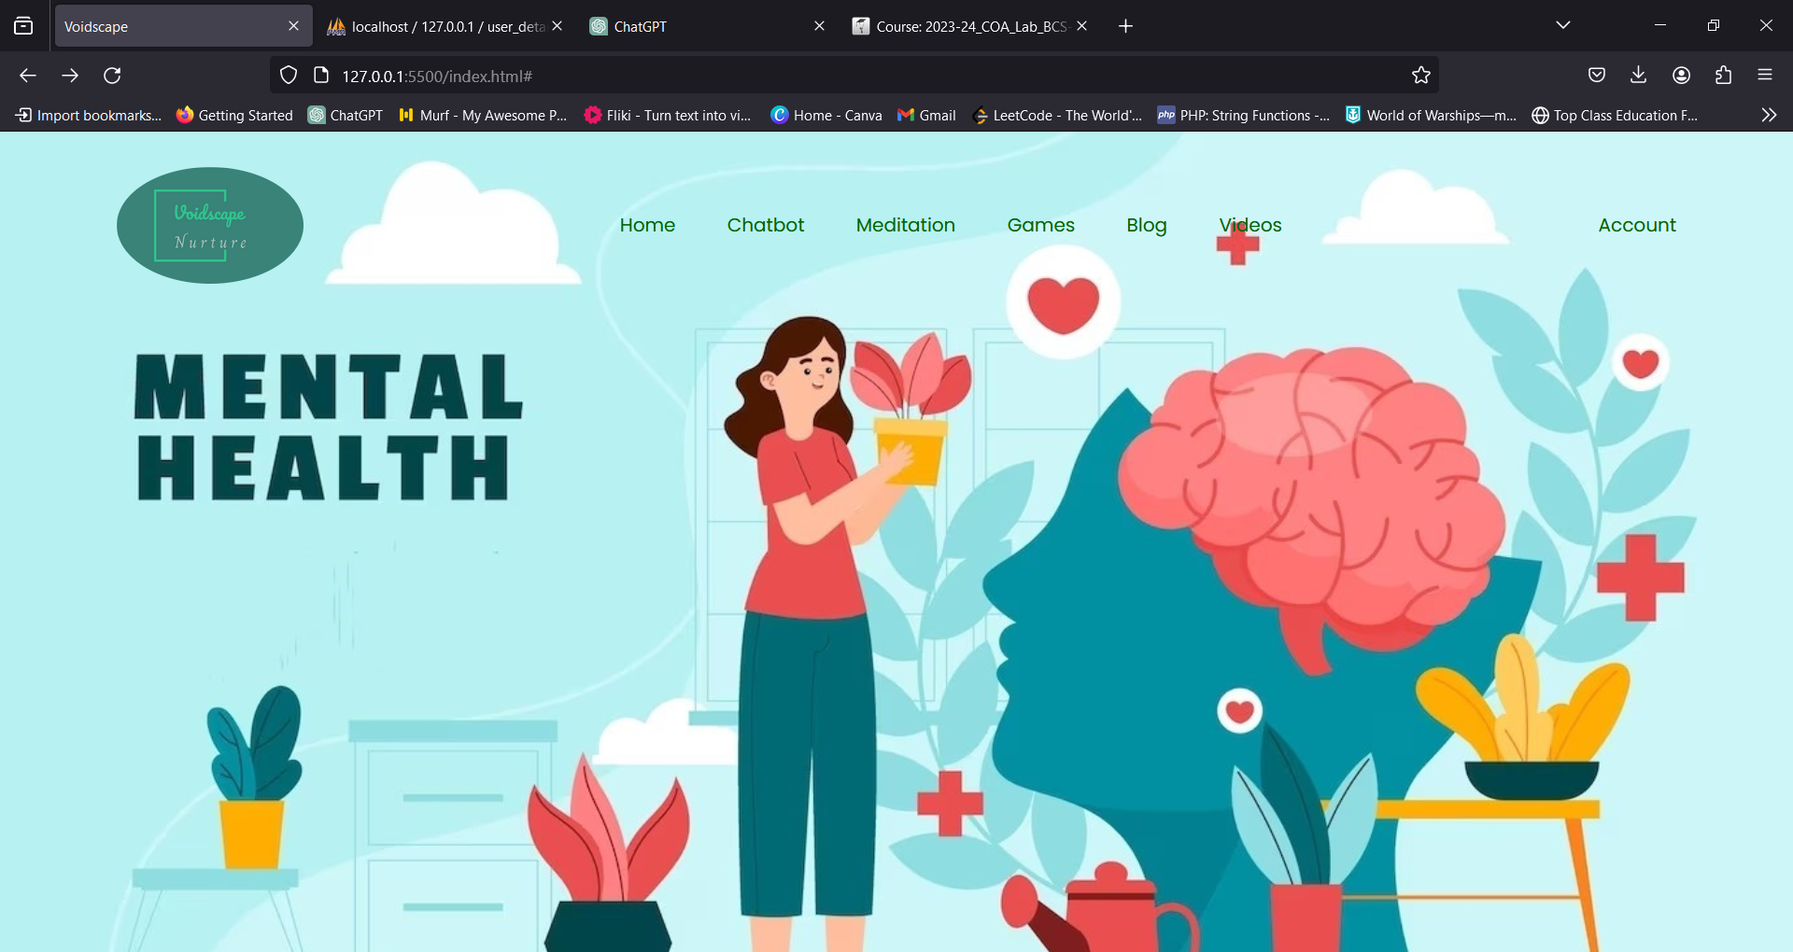

Slide 6
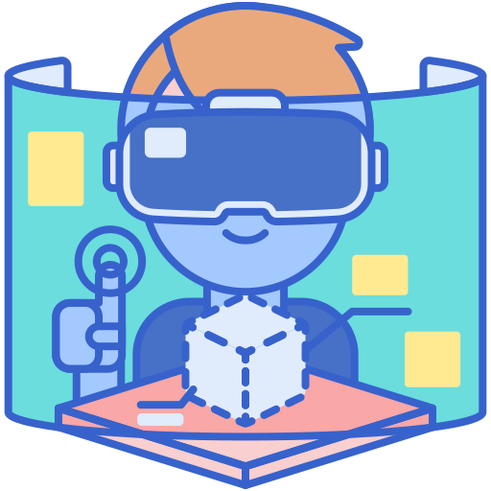
VR MEDITATION
Virtual Reality creates immersive environments that can transport individuals to serene and calming settings. By using VR headsets, users can escape the stresses of the real world, facilitating deep relaxation and mindfulness. This technology offers a controlled and customizable meditation experience, allowing users to tailor their environment to suit their preferences for a more effective meditation session.

Slide 7
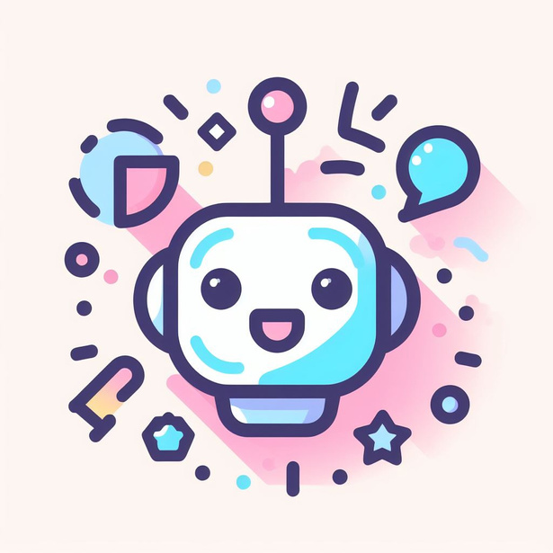
CHATBOT
A chatbot can behave like a therapist providing emotional support to people with anxiety & depression.

Slide 8
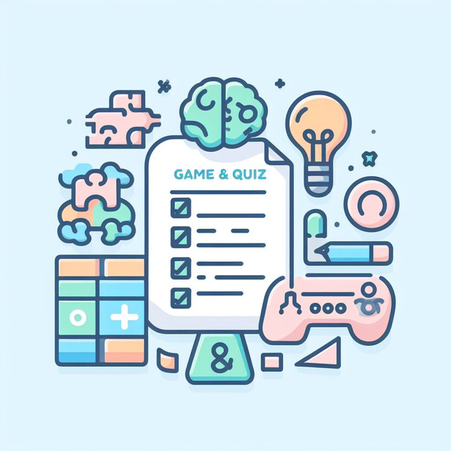
GAMES
Mini soothing games are small, simple games that can help users to relax and relieve stress and anxiety. They are often designed to be played for short periods of time, making them ideal for use on-the-go or when feeling overwhelmed.

Slide 9

BLOG
Mental health blogs can cover a wide range of topics, including:
Self-care and stress management techniques
Overcoming stigma and promoting mental health awareness
Nurturing healthy relationships
Mental health and nutrition

Slide 10
MOTIVATION & CONSULTANCY
Providing video resources for relaxing & guidance to help people overcome daily life stress and anxiety. These resources are enough to work with people of all ages and backgrounds.
Teach people skills for coping with stress and anxiety.
Help people to build confidence and self-esteem.

Slide 11
fereferf
Tech Stacks
Unity Engine
PHP
MySQL
C#
HTML, CSS & JS
Python, NLP

